Slide 1

VERQUVO® 2023 Marketing Budget Optimization
Impact Assessment & Investment Optimization
HH Digital, Data and Analytics (HHDDA)
Aug 17th, 2023

Slide 2
Objective and Executive summary
Objective: Suggest optimal investment across In-scope HCC & HCP channels for a given budget to maximize the overall impactable revenue in 2024.
2023 In-scope¹ estimated budget contribution: The In-Scope¹ investment of $14M (total budget $32M) is estimated to generate ~$25.4M in 3-yr pre-tax incremental revenue (ROI excl. samples/vouchers=1.1:1).
2023 Optimal Spend and allocation: The In-Scope¹ investment of $14M is estimated to generate ~$28.8M in 3-yr pre-tax incremental revenue (ROI excl. samples/vouchers=1.3:1).
¹In-Scope channels : HCP MCM, HCP MF, HCC InOffice, HCC Social, HCC Display, HCC Paid Search, Samples and Vouchers

Slide 3
Agenda
Understanding analyzable budget
Budget scenarios and impact on incremental revenue
Channel promotion efficiency and responsiveness
Deep-dive budget scenarios

Slide 4
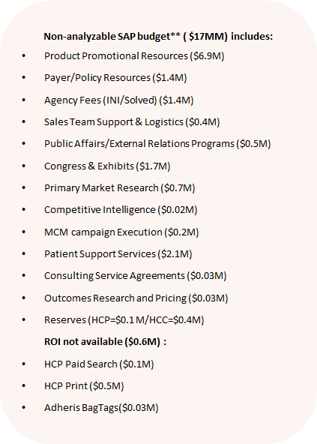
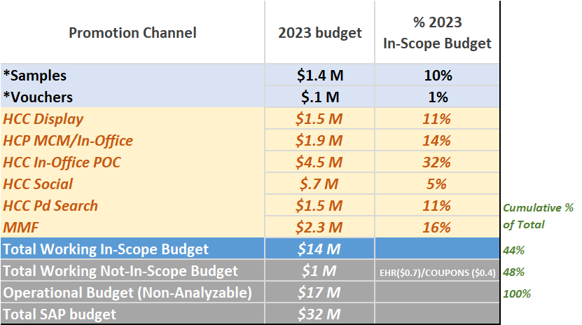
In-Scope Promotion Budget for Analysis
~44% ($14M) of the total 2023 VERQUVO® promotion budget was analyzed
The combined working budget represents 48% of the total budget
* Includes only Cost of Goods (COG) for Samples and reimbursement cost for Vouchers
**Source: Media Plans dated July’23, SAP Report dated June’23

Slide 5
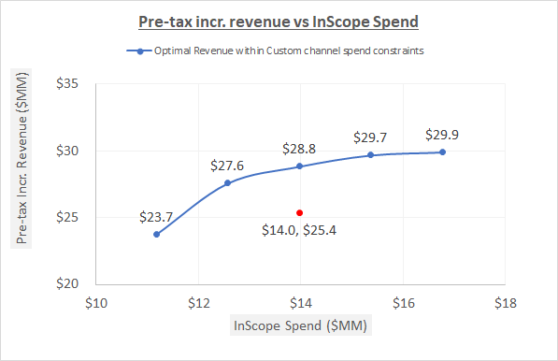
Optimal Scenarios
The current 2023 spend of $14M can be optimized to return additional $3.4 M in incremental revenue
Optimal scenarios were studied for 5 investment levels :
-20% in-scope ($11M)
-10% in-scope ($12.5M)
2023 in-scope(14M)
+10% in-scope ($15.3M)
+20% in-scope ($16.8M)
Within the current budget there is plenty of opportunity to optimize across channels and improve revenue substantially. By optimizing the current in-scope spend ($14M) with +/-40% channel variation, a $3.4M gain in Revenue is estimated.
 | 2023 Aug FC ($M) | 2024 Aug FC ($M)
Total Budget | $31.7 | $32
InScope Budget (~44%) | $14 | TBD
These calculations assume that the non-analyzable budget can decrease proportionately to the in-scope budget

Slide 6
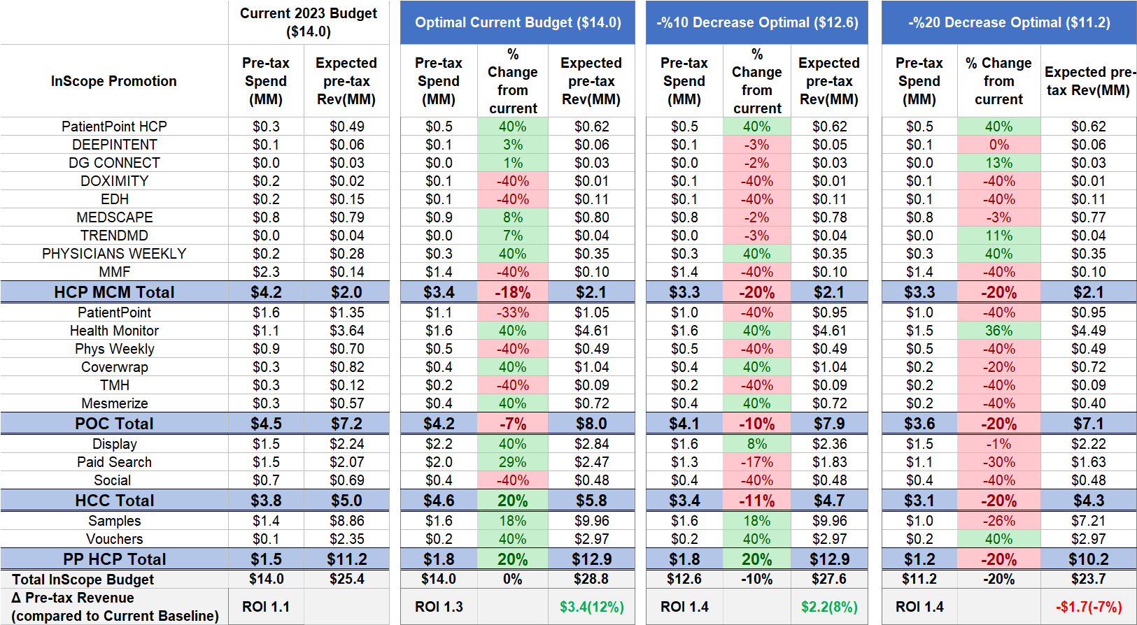
Optimal Scenario deep dive (decreasing scenarios)
With the existing budget, an additional $3.4M in revenue can be gained by reallocating from lower impact to higher impact channels.
*Samples are requested and received by prescribers for use by and benefit of patients. Samples provide the opportunity to gain experience with a product. The sample-related values shown here reflect the association between samples and new patient starts rescaled into TRx terms for comparability to other investment types; this applies to vouchers as well, which are treated as an alternative mechanism to provide samples to patients. (vs. samples left by Field personnel).

Slide 7
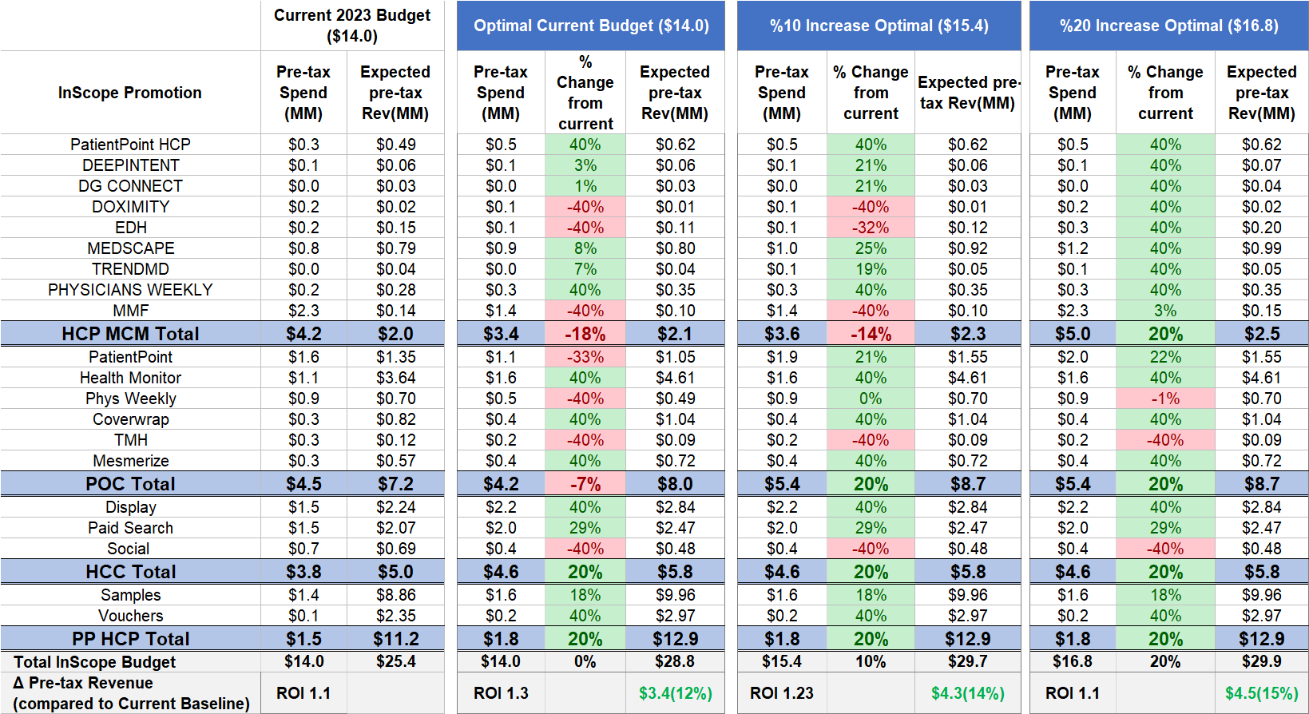
Optimal Scenario deep dive (increasing scenarios)
With the existing budget, an additional $3.4M in revenue can be gained by reallocating from lower impact to higher impact channels.
*Samples are requested and received by prescribers for use by and benefit of patients. Samples provide the opportunity to gain experience with a product. The sample-related values shown here reflect the association between samples and new patient starts rescaled into TRx terms for comparability to other investment types; this applies to vouchers as well, which are treated as an alternative mechanism to provide samples to patients. (vs. samples left by Field personnel).

Slide 8
Next Steps
Receive practical channel level constraints (lower and upper) from the marketing team
Run custom scenarios to take the new constraints into account
Reach a consensus on the final scenario – budget and channel allocation

Slide 9
APPENDIX

Slide 10
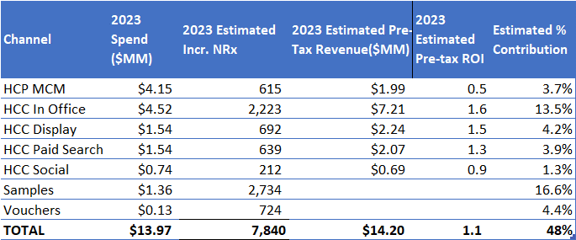
Estimated Pre-tax ROIs and % Contribution for 2023 The Total estimated contribution from all In-Scope promotion channels is 48%

Slide 11
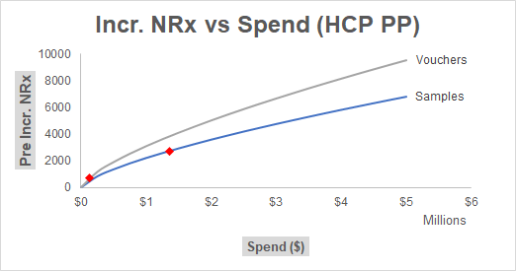
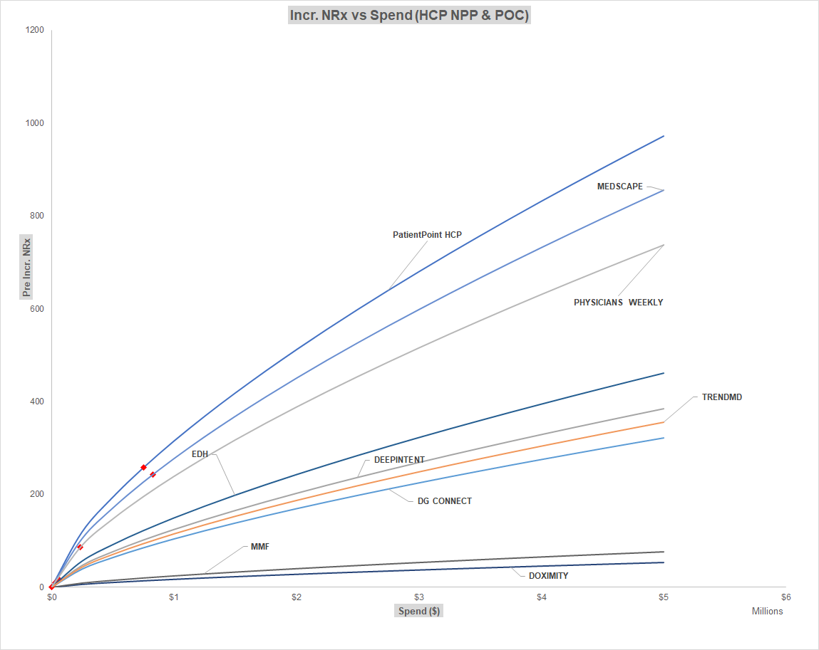
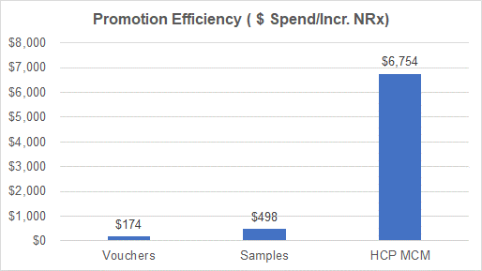
Promotion Deep dive for HCP MCM and HCP PP

Slide 12
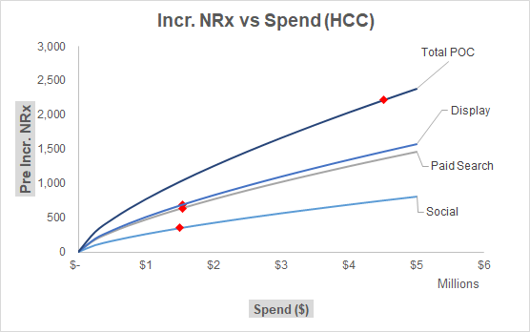
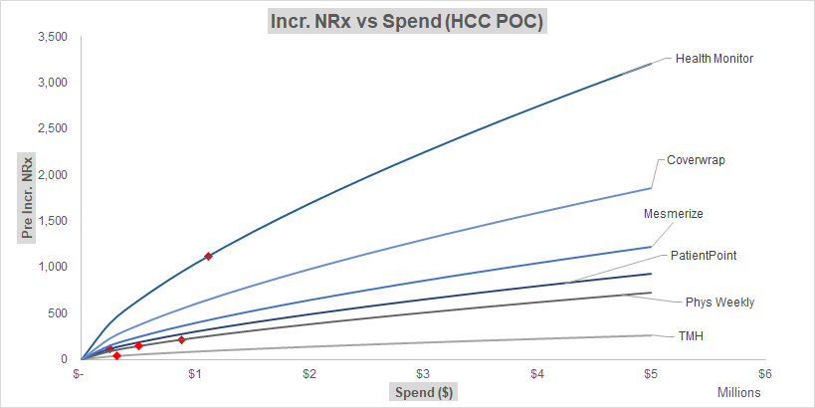
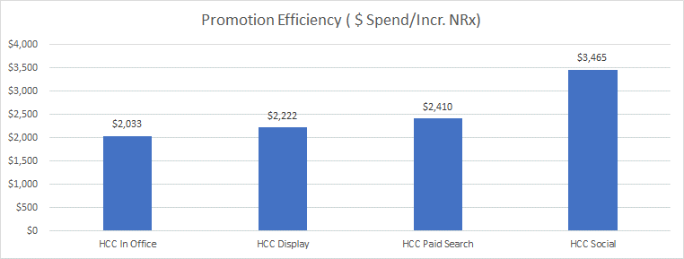
Promotion Deep dive for HCC and HCC POC

